Slide 1


Data Analysis

Slide 2


Today's agenda
Project recap
Problem
The Analytics team
Process
Insights
Summary

Slide 3

Social Buzz is a fast growing technology unicorn that need to adapt quickly to it’s global scale. Accenture has begun a 3 month POC focusing on these tasks:
An audit of Social Buzz’s big data practice
Recommendations for a successful IPO
Analysis to find Social Buzz’s top 5 most popular categories of content
Project Recap

Slide 4

Problem
Over 100 000 posts per day
36 500 00 pieces of content per year!
But how to capitalize on it when there is so much?
Analysis to find Social Buzz’s top 5 most popular categories of content

Slide 5



Zhibek Abdyramanova
Data Analyst
The Analytics team
Marcus Rompton
Senior Principle
Andrew Fleming
Chief Technical Architect

Slide 6
Process
1
Data understanding
2
Data cleaning
3
Data modelling
4
Data analysis
5
Uncover insights

Slide 7

Insights
16 unique categories
Most popular category is animal
The top-3 reactions on animals are scared, peeking, hate!
May 2021 is the most active month is terms of posts: 2138 posts!

Slide 8
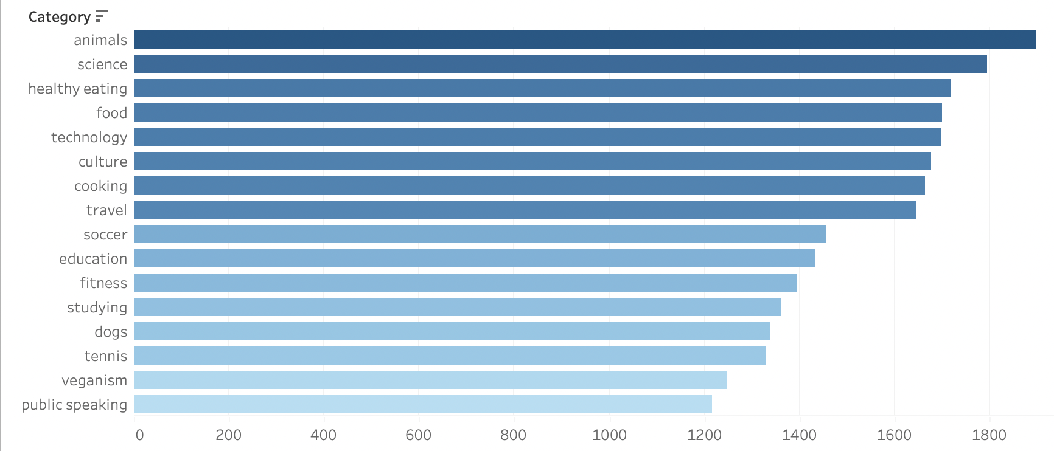

Slide 9
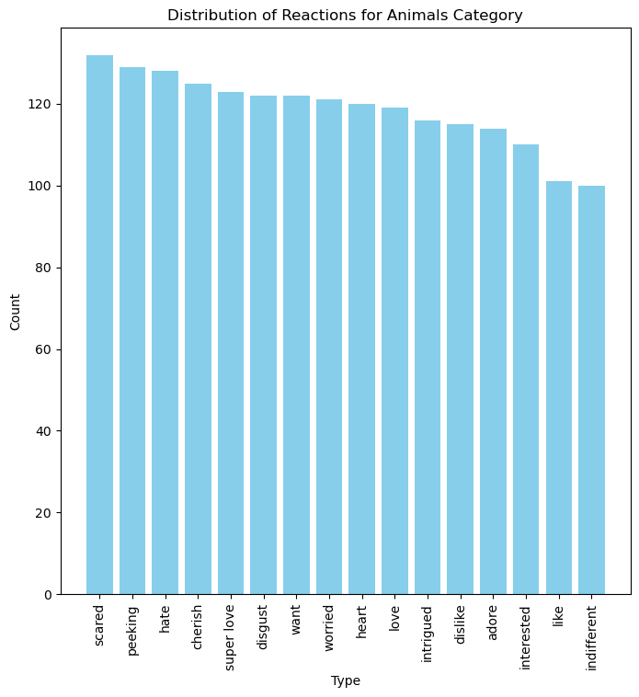
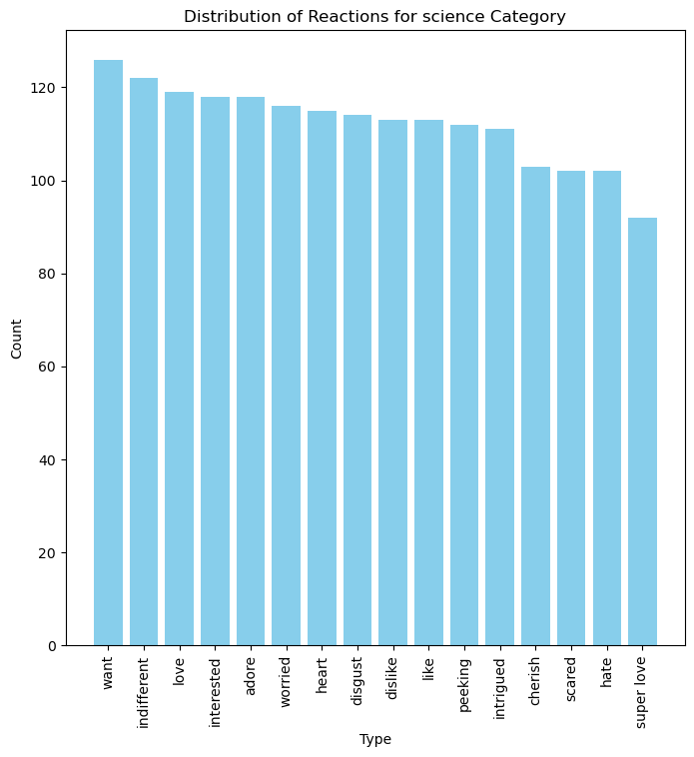
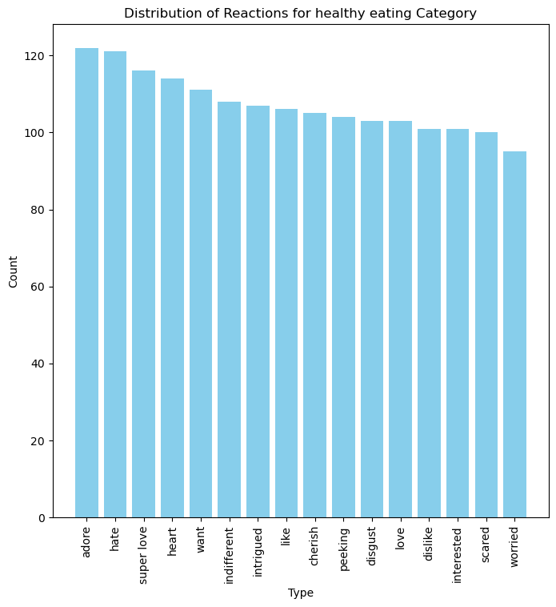

Slide 10
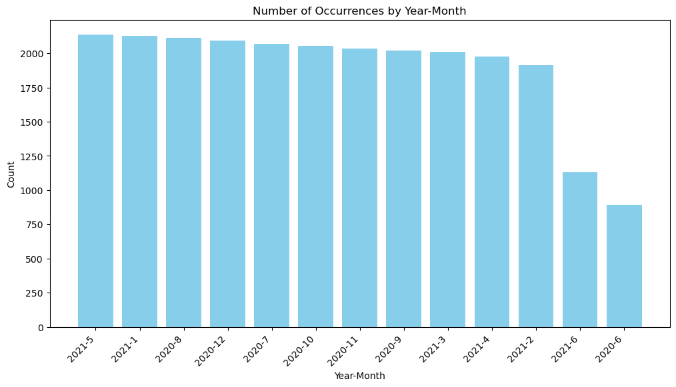

Slide 11

In total there are 16 categories. Top-5 categories are animals, science, healthy eating, food, technology. Interestingly there is a separate popular category dogs.
Majority of users used heart, scared and peeking reactions for animals. For science category reactions were want, indifferent, love. As to healthy eating the reactions distributions were as follows as follows adore, hearts, super love.
Summary
Users were posting most actively in May and January 2021. The third most active moth was in August 2020. Around 2000 posts per month.

Slide 12

Thank you!
ANY QUESTIONS?

